Slide 1
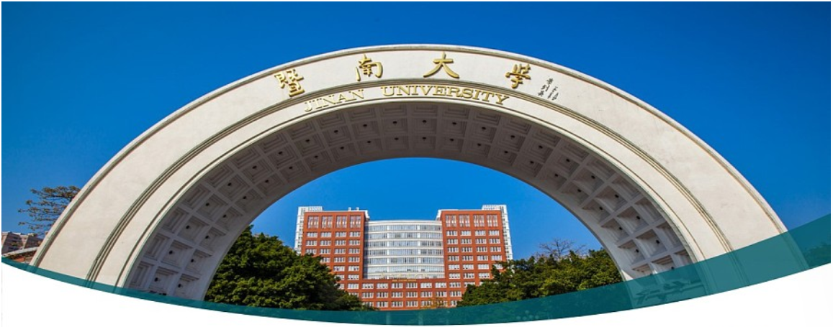

数字图像处理 1. 课程介绍
汤知日, 副教授
智能科学与工程学院

Slide 2


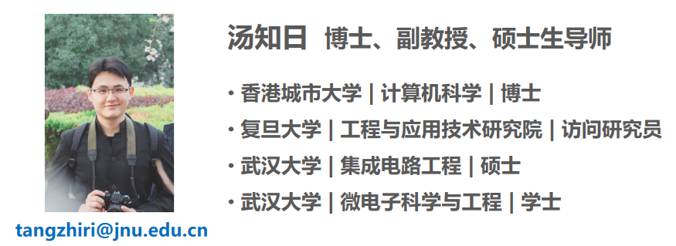
研究方向：方法层面：认知计算、机器学习、数据挖掘、深度学习以及面向数据/标签缺省的算法架构，包括半监督/无监督/弱监督/迁移学习等；应用层面：生物医学信息学，图像和信号处理，以及其他智慧医疗等
研究成果：在IEEE JBHI、TCYB和TCDS等权威SCI期刊/国际会议上发表SCI论文多篇，相关工作被包括Nature子刊、IEEE汇刊的等多次正面评价，谷歌学术被引超过1000次，H因子20
获得奖励：2018年Intel InnovateFPGA全球创新大赛大中华区决赛银牌及一等奖，香港城市大学杰出学术表现奖/研究学费奖学金（2020/2021/2022）等
学术兼职：Frontiers in Neuroscience/Frontiers in Computational Neuroscience客座编辑，ISMSI 2025/ICONIP2022/ICCCN2022等国际会议程序委员会

Slide 3
理论课程评分比例
Attendance: 30%
Final exam: 70%

Slide 4
实验课程评分细则
Attendance: 10%
Programming & report: 30% (6*5%)
Final project report：60%

Slide 5
Final project (60%)
Requirements:
Topic: Related to digital image processing
Team: 2~3 teammates
Language: Chinese or English? NA. You can also use French or Russian if you want. Article in Fluent English could help you obtain a higher score (3~4%).
Length or pages: NA. Your score depends on your workload.
Oral presentations are a plus (with a harsh Q&A) from week 9
The hard deadline for ALL reports is Week 18, Wednesday, Jan 1 @ 6pm. Any work submitted after this deadline will not be graded.

Slide 6
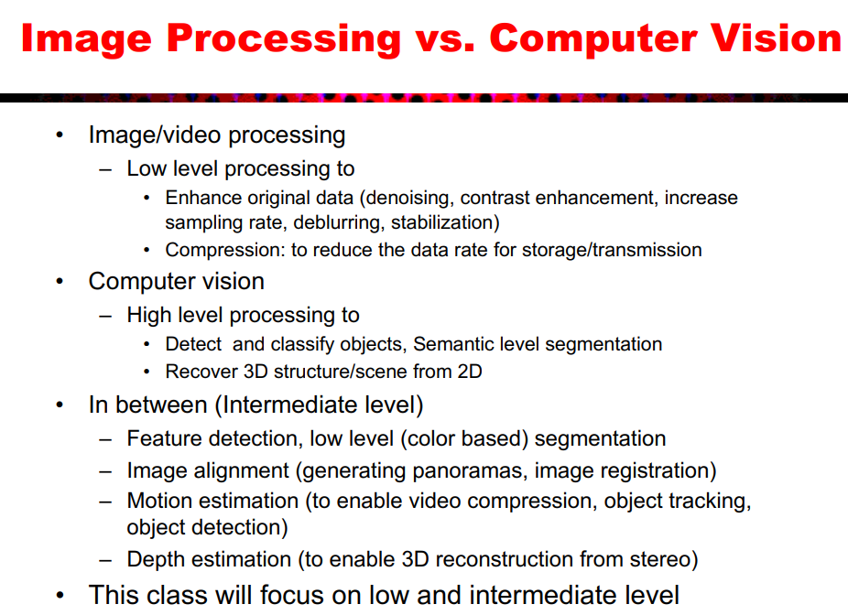

Slide 7
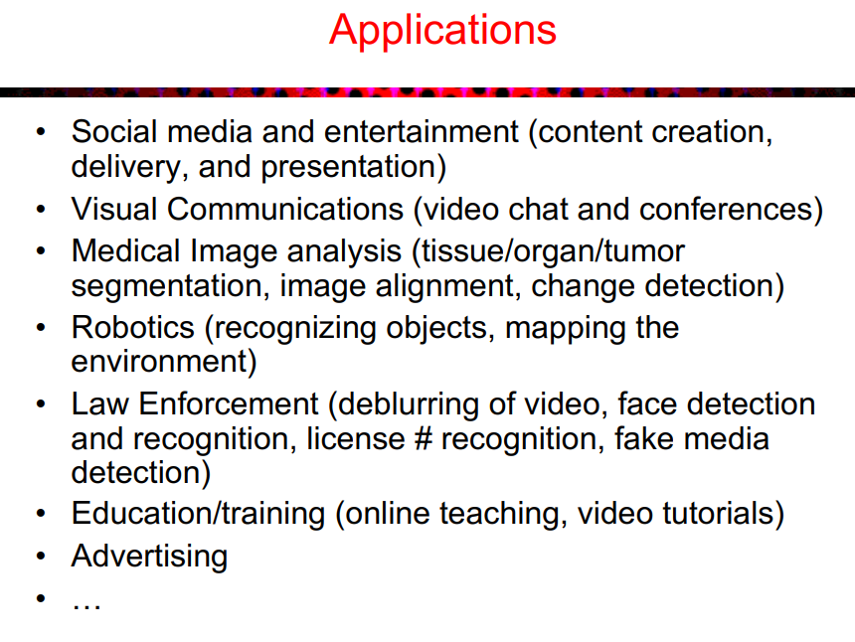

Slide 8
Final project (60%)
Contents:
Level 2 (general score): A survey or summary for one specific image processing topic, including but not limited to related works in recent years, theory, drawbacks, applications, potentials in the future, etc.
Level 1 (high score): A reproduction for current frameworks, including but not limited to the main ideas/contributions of this framework, related works, theory, framework descriptions, source code, experiments, conclusion, etc.
Level 0 (very high score): An improvement based on current frameworks, including but not limited to the main ideas/contributions of this framework and some improvements, related works, theory, descriptions on framework and improvement, source code, experiments (baseline and ablation study), conclusion, etc.
NOTE: don’t worry about whether the idea could improve the evaluation metrics. The key is a suitable idea.

Slide 9
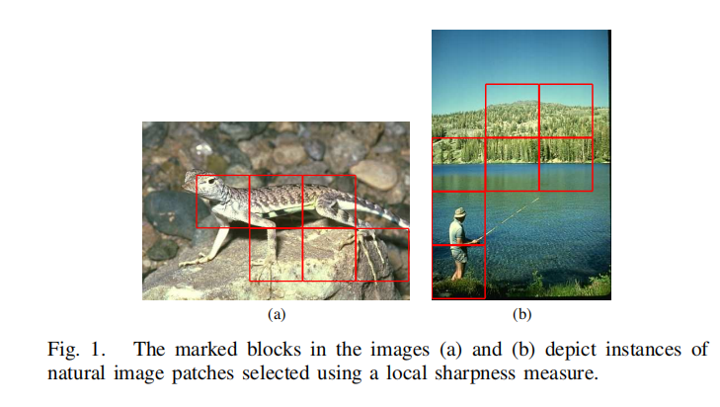
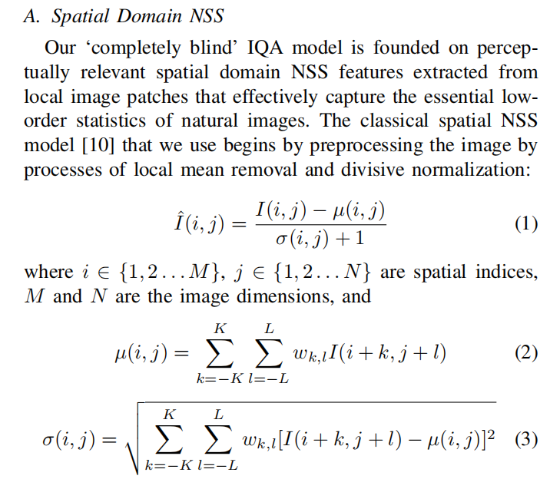
Final project (60%)
An example of Level 0:
Article structure: Title, Abstract (~250 words), Keyworks (3~5), Introduction (including background, drawbacks, how we solve these problems in this article, main contributions), Related works in recent years, Framework (with some nice figures), Experiments (including experimental setup, datasets, experimental results. It also needs nice figures and tables), Conclusions and Discussions.

Slide 10
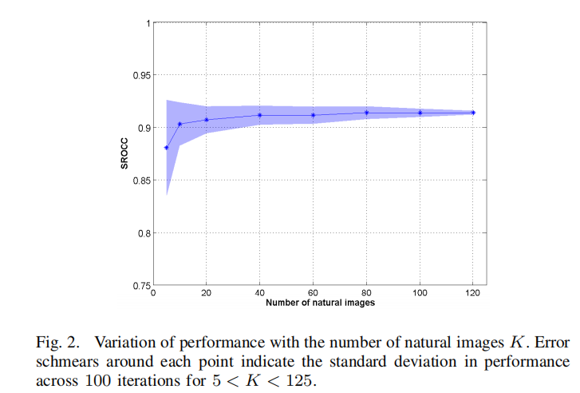
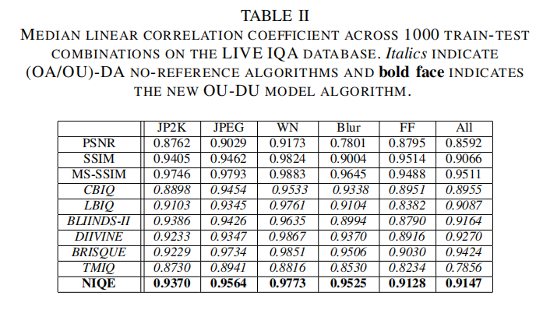
Final project (60%)
An example of Level 0:
Article structure: Title, Abstract (~250 words), Keyworks (3~5), Introduction (including background, drawbacks, how we solve these problems in this article, main contributions), Related works in recent years, Framework (with some nice figures), Experiments (including experimental setup, datasets, experimental results. It also needs nice figures and tables), Conclusions and Discussions.

Slide 11
Final project (60%)
Important publication venues:
Conference:
CVPR (Conference on Computer Vision and Pattern Recognition)
ICCV (International Conference on Computer Vision)
ECCV (European Conference on Computer Vision)
ICIP (International Conference on Image Processing)
Journal:
IEEE Transactions on Pattern Analysis and Machine Intelligence
IEEE Transactions on Image Processing
There are also some other top conferences/journals on general topics, such as Journal of Machine Learning Research (JMLR), IEEE Transactions on Neural Networks and learning systems (TNNLS), Annual Conference on Neural Information Processing Systems (NIPS), AAAI Conference on Artificial Intelligence (AAAI), etc.
TIPS: Some papers with source code will help you a lot.

Slide 12
Final project (60%)
Academic Honesty:
How to prevent plagiarism...
Finish the assignments by yourself! You have to write the program/solution yourself.
okay to talk about how to do the problem with your classmates.
Protect your code; don't give it away as a "reference" copy.
In plagiarism cases, we treat the giver and the copier as both guilty.
You hurt your own grades by not reporting cheating.
About using ChatGPT...
You can use chatgpt to do the translation, but please make sure that the idea and experiments of the article are done by yourself.
Idea is the main contribution of your work. Even if other people are using a similar framework and improvement scheme to you, you will definitely think and train differently.
We have AI detection.
How much work you put in, how many points you obtain.

Slide 13
数字图像处理 2. 基础知识

Slide 14
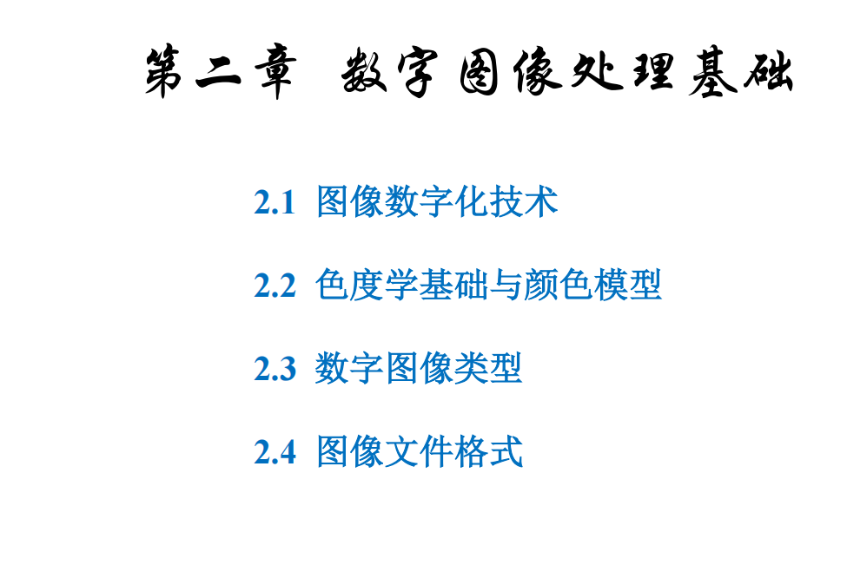

Slide 15
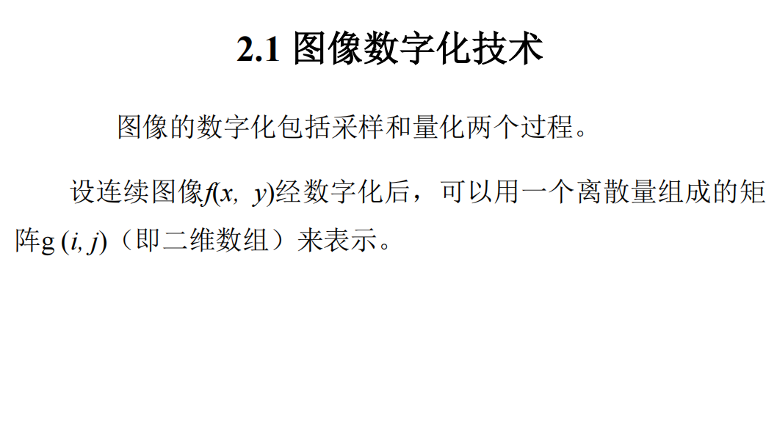

Slide 16
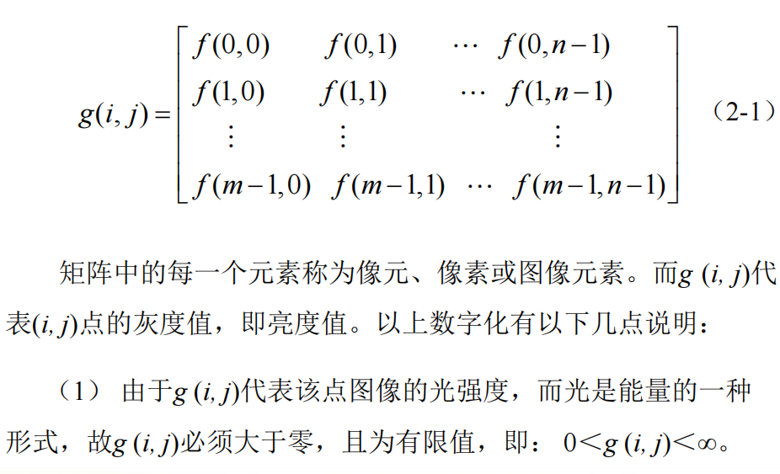

Slide 17
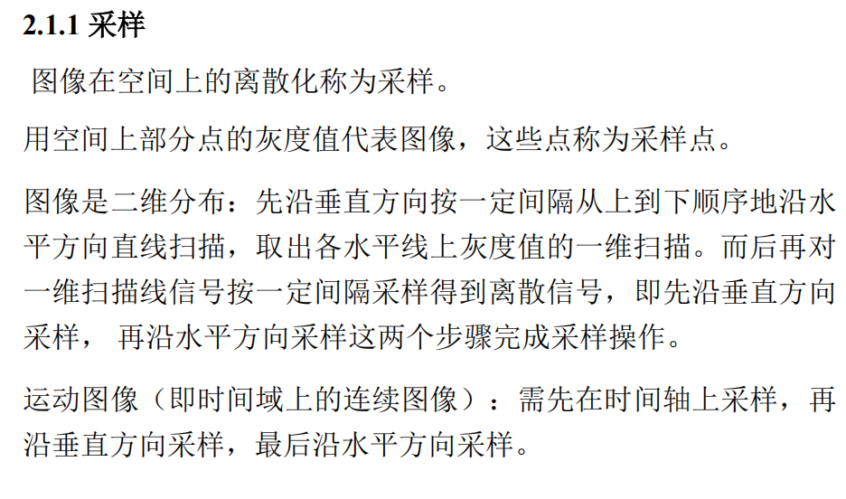

Slide 18
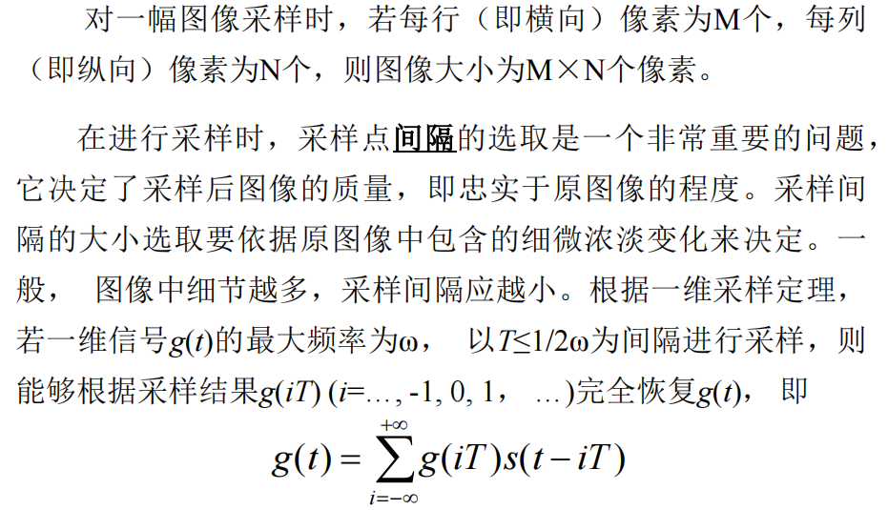
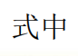
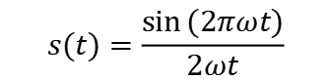
$$s(t)=\frac{\sin{(2πωt)}}{2ωt}$$

Slide 19
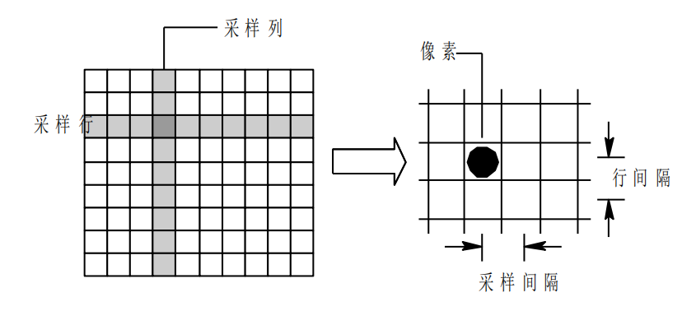
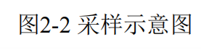

Slide 20
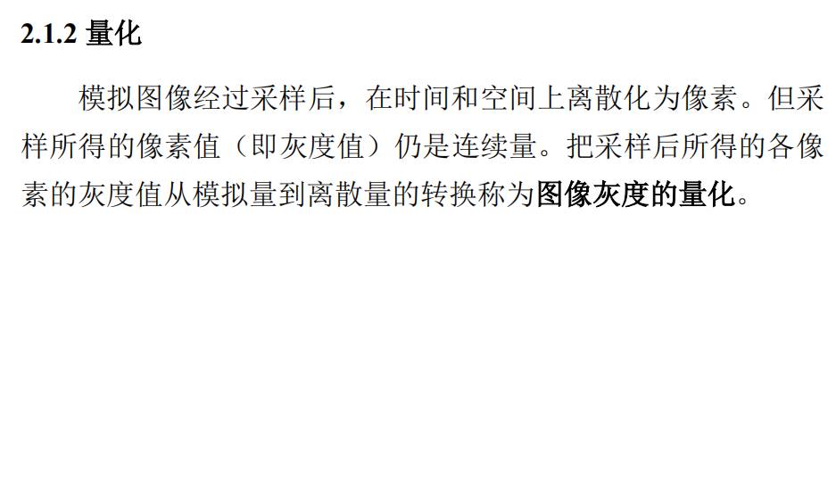
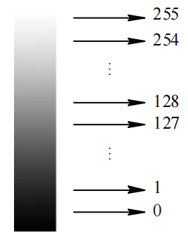
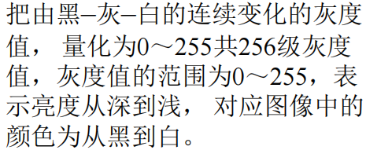
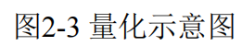

Slide 21
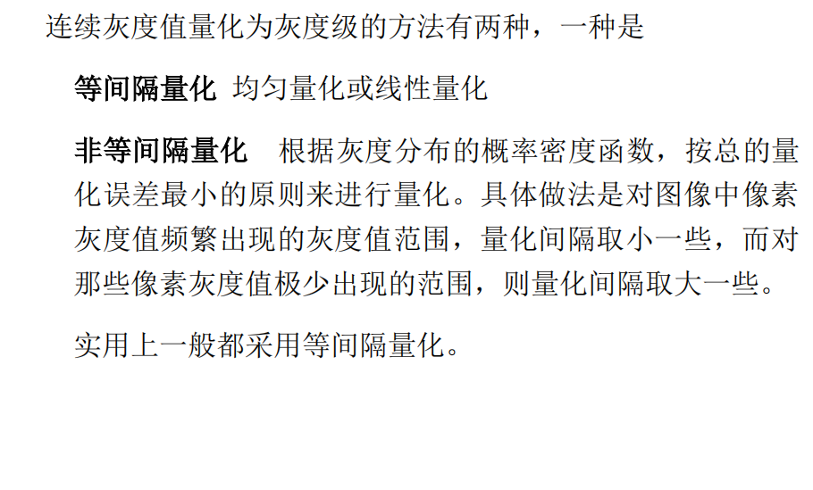

Slide 22
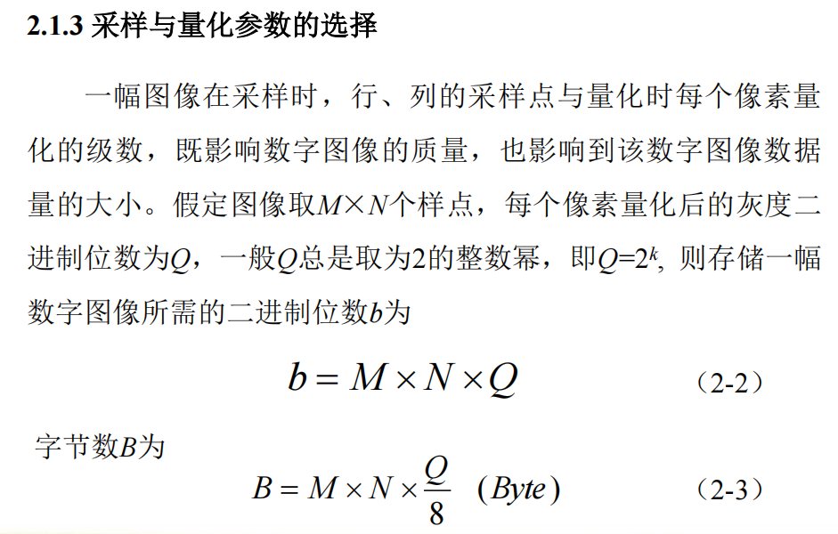

Slide 23
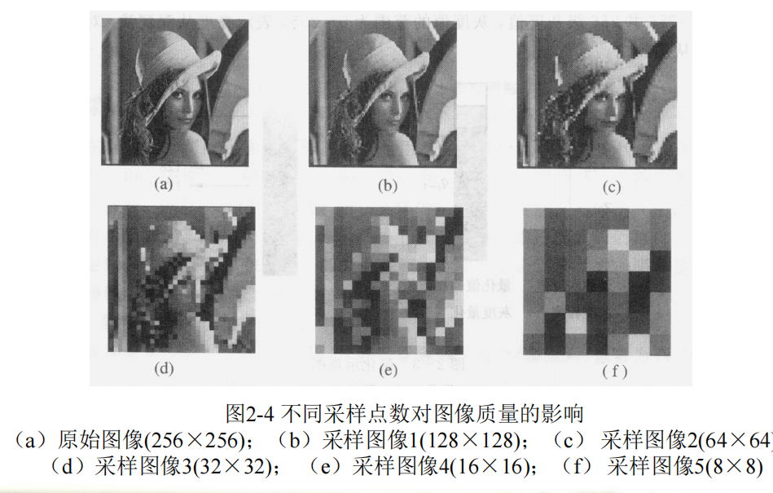

Slide 24
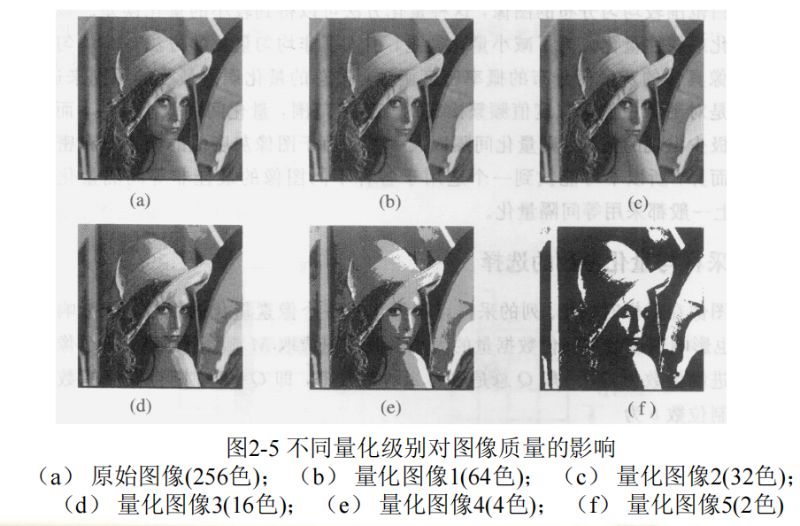

Slide 25
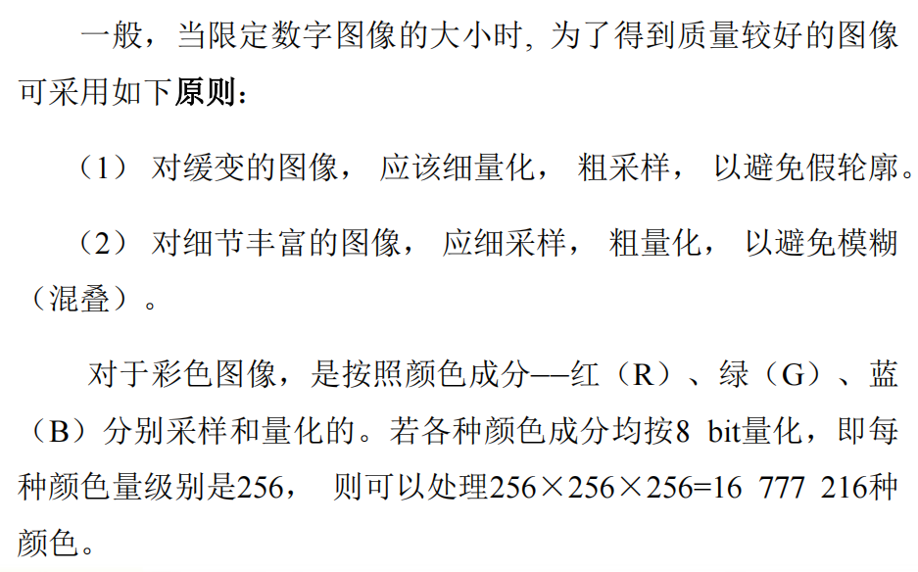

Slide 26
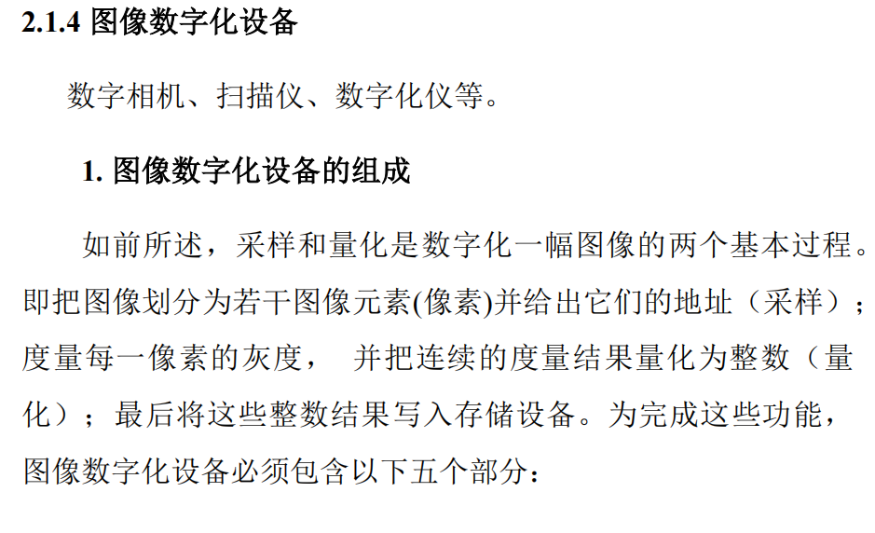

Slide 27
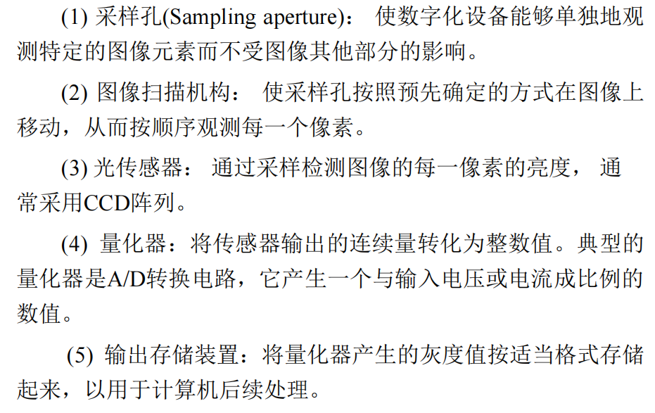

Slide 28
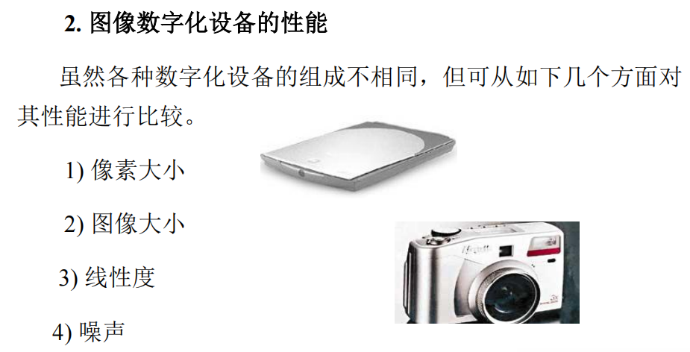

Slide 29
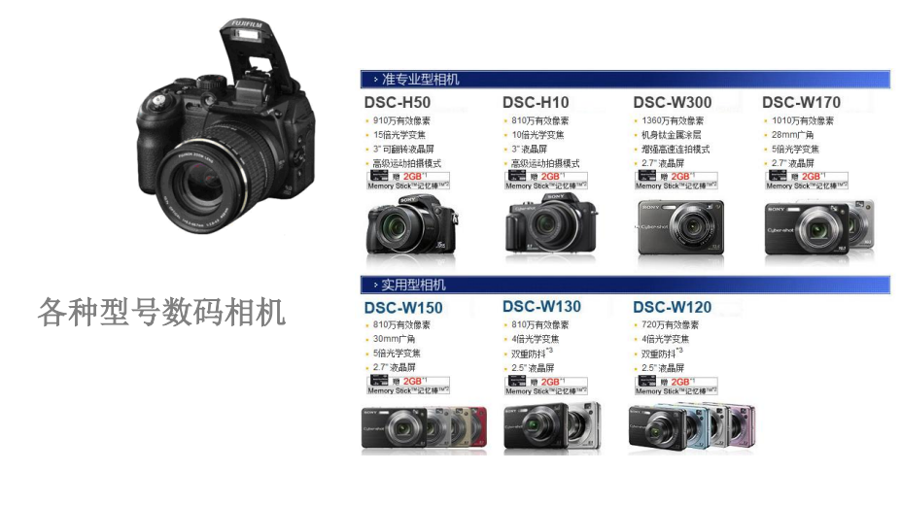

Slide 30
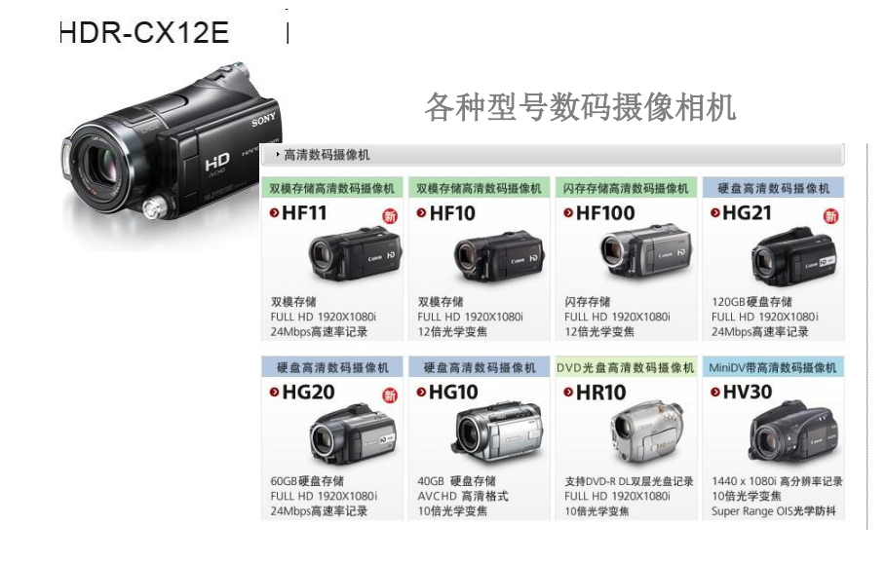

Slide 31
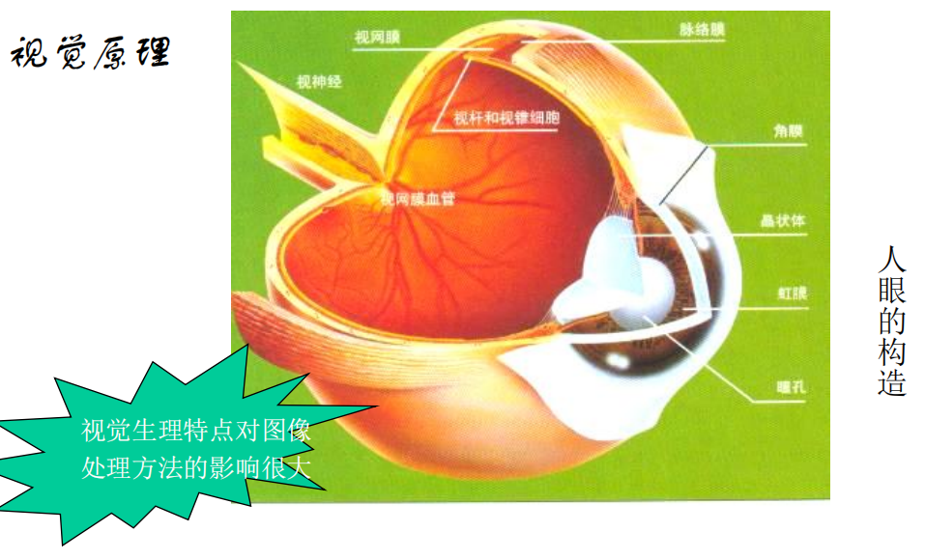

Slide 32
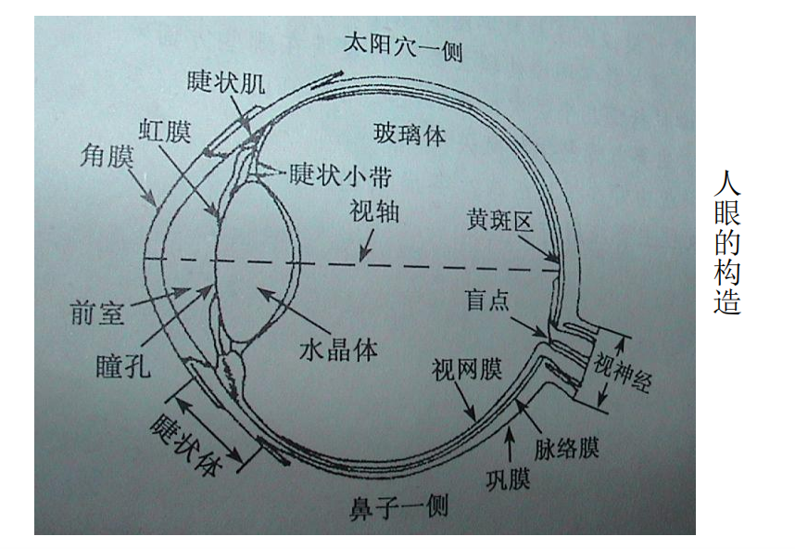

Slide 33
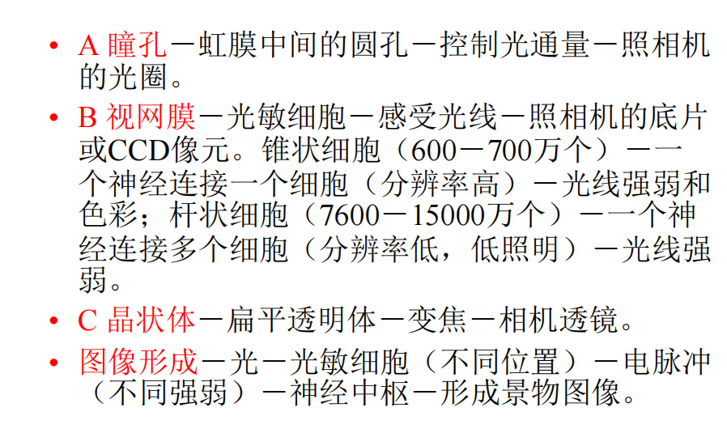

Slide 34
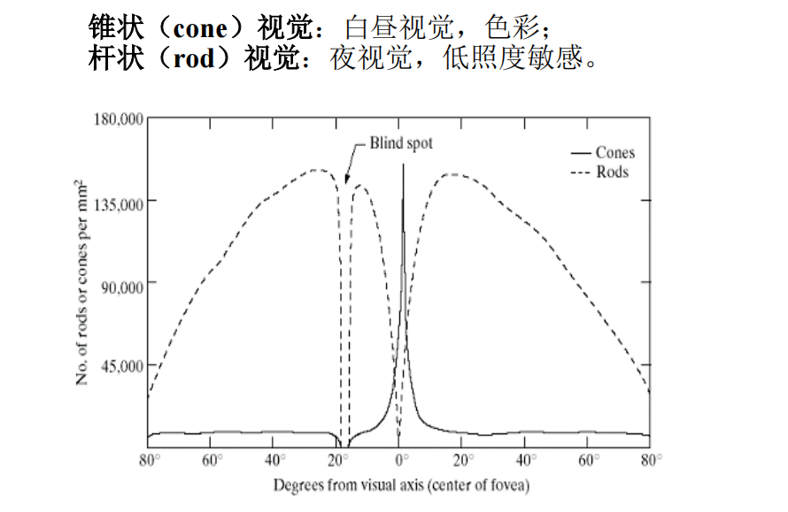

Slide 35
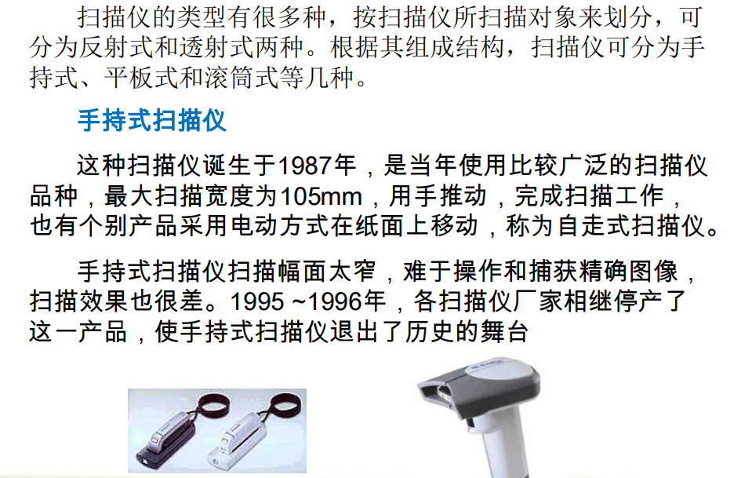

Slide 36
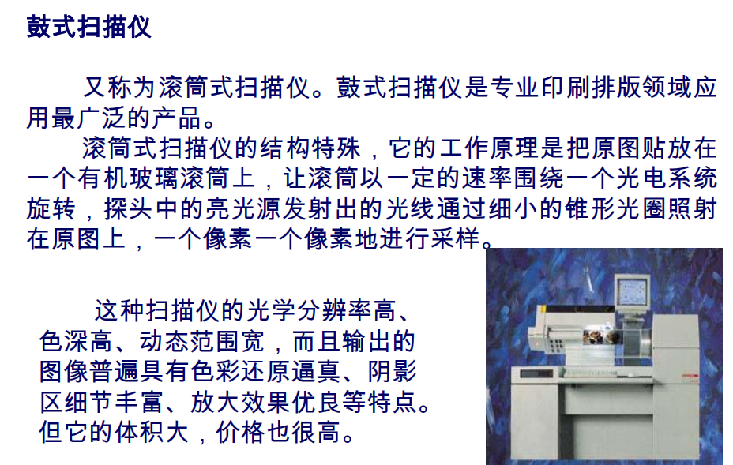

Slide 37
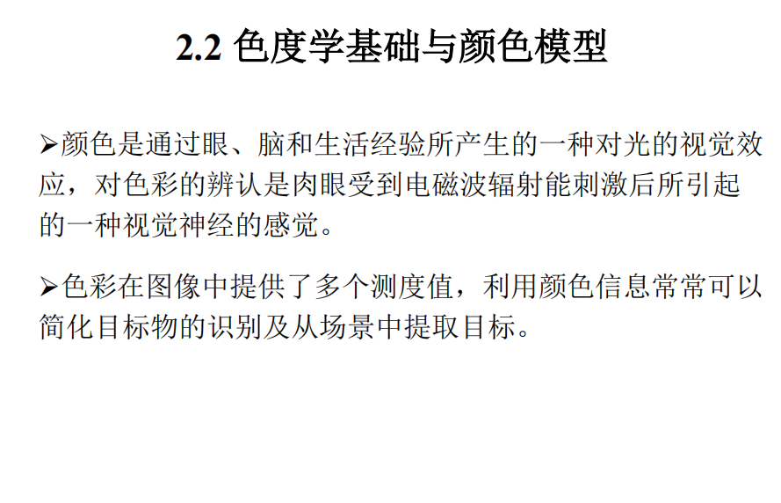

Slide 38
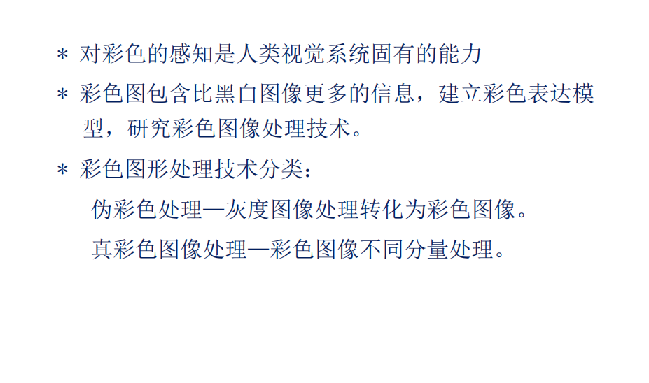

Slide 39
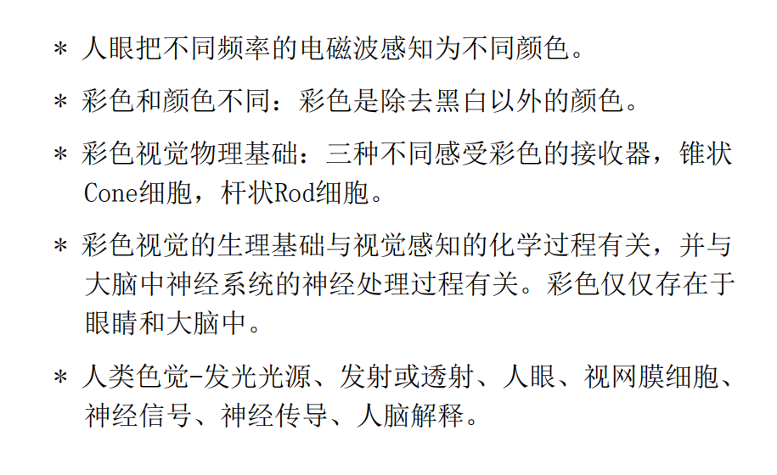

Slide 40
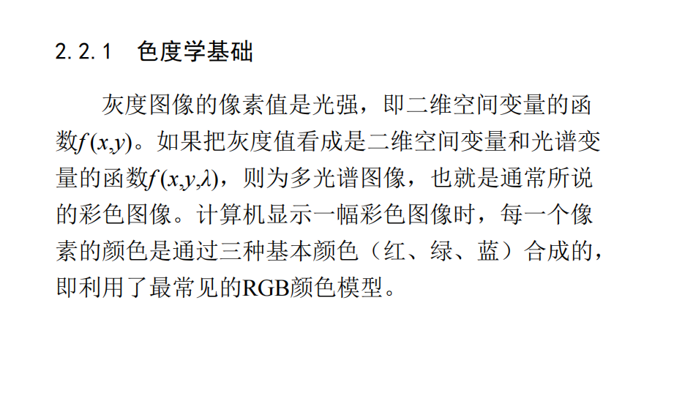

Slide 41
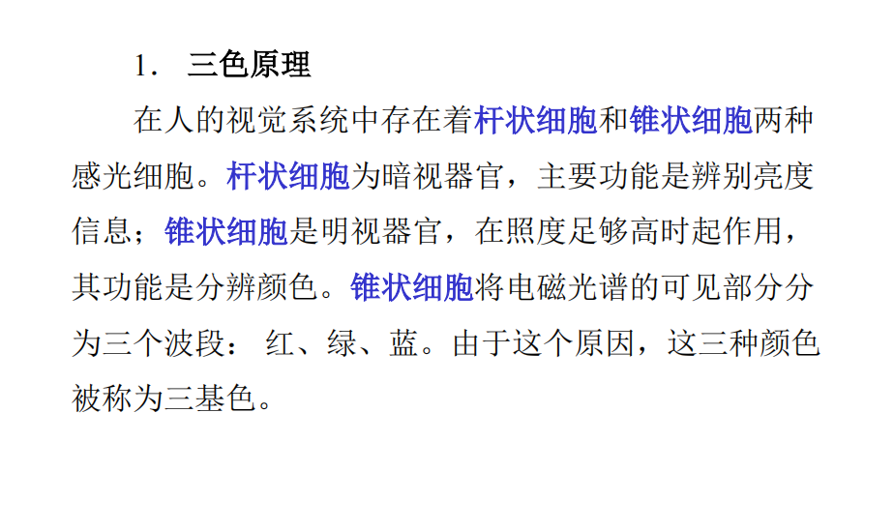

Slide 42
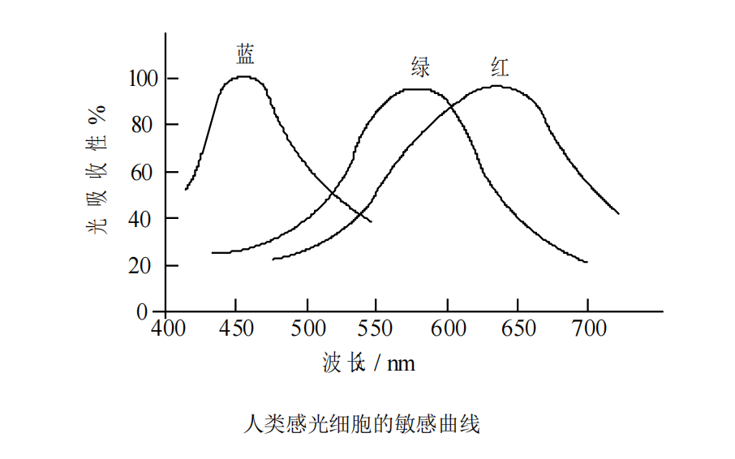

Slide 43
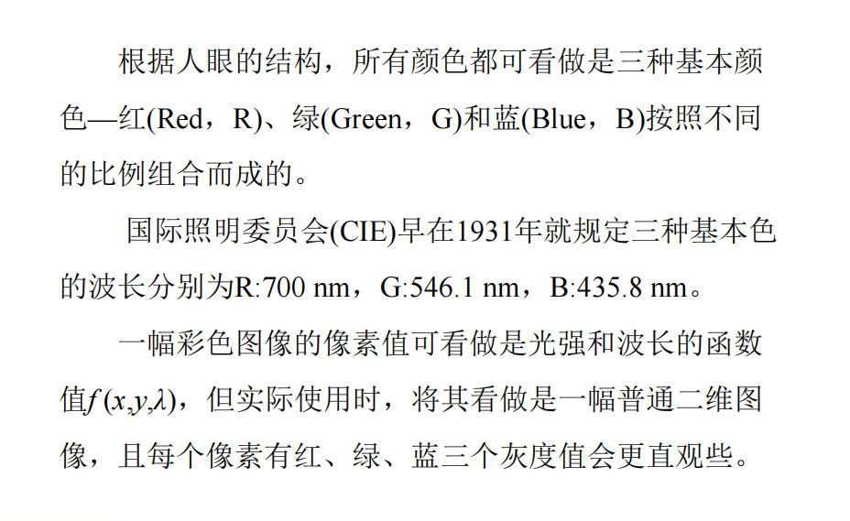

Slide 44
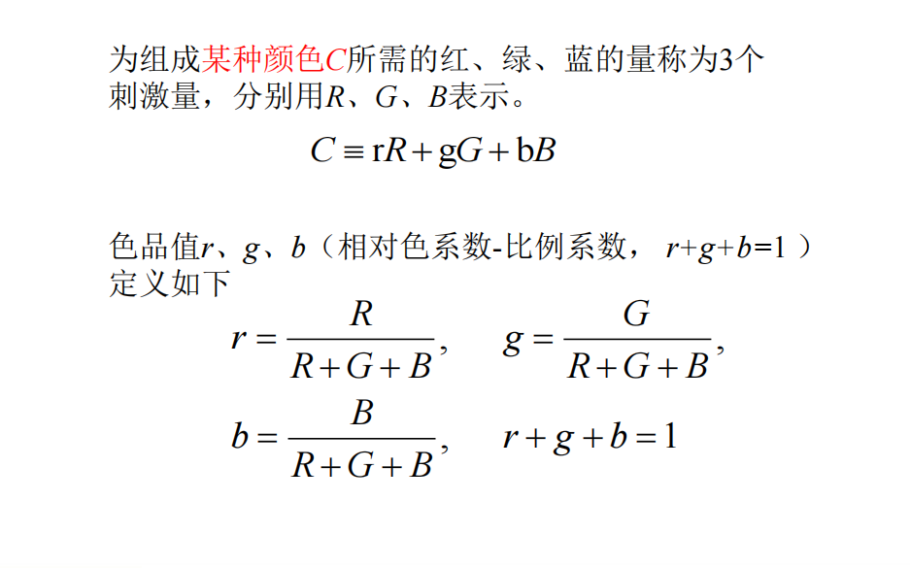

Slide 45
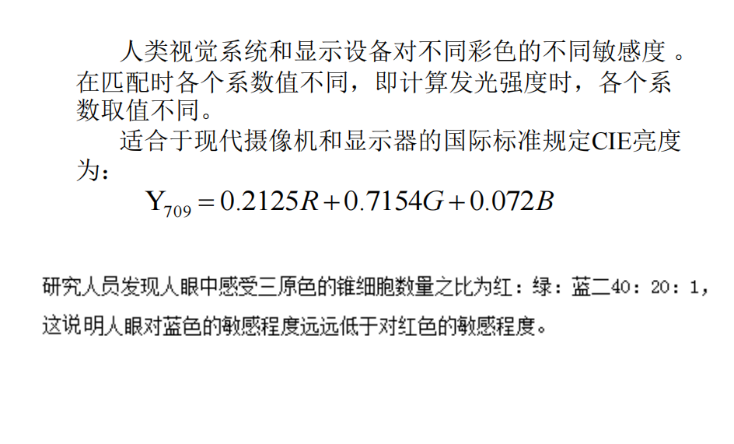

Slide 46
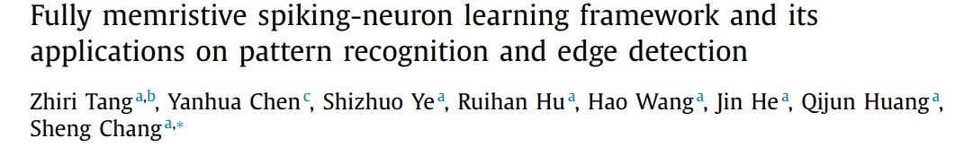
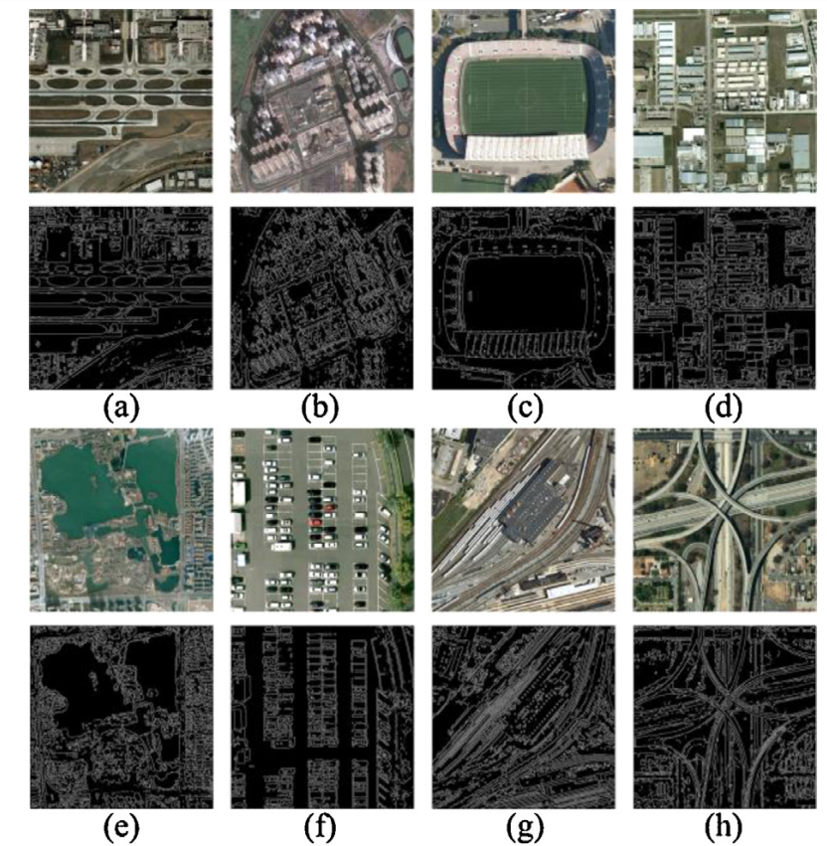
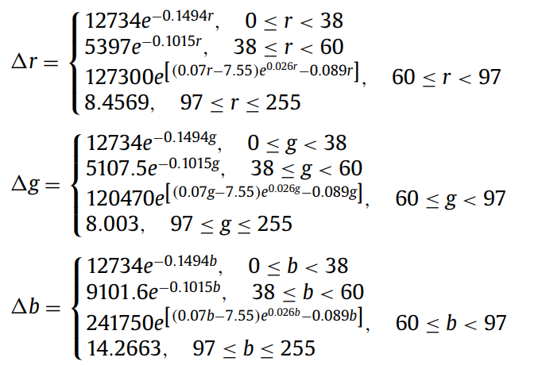
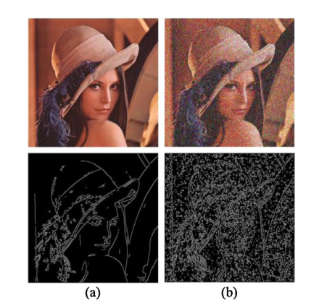


Slide 47


Slide 48


Slide 49


Slide 50


Slide 51


Slide 52


Slide 53


Slide 54


Slide 55


Slide 56


Slide 57


Slide 58


Slide 59


Slide 60


Slide 61


Slide 62


Slide 63


Slide 64


Slide 65


Slide 66


Slide 67


Slide 68


Slide 69


Slide 70


Slide 71


Slide 72


Slide 73


Slide 74


Slide 75


Slide 76


Slide 77


Slide 78


Slide 79


Slide 80


Slide 81


Slide 82


Slide 83


Slide 84


Slide 85


Slide 86




Slide 87


Slide 88


Slide 89


Slide 90


Slide 91


Slide 92


Slide 93


Slide 94


Slide 95


Slide 96


Slide 97


Slide 98


Slide 99


Slide 100



Slide 101


Slide 102


Slide 103


Slide 104


Slide 105


Slide 106


Slide 107


Slide 108


Slide 109


Slide 110


Slide 111


Slide 112


Slide 113


Slide 114


Slide 115

时，构成该图像具体颜色的索引值就被读入程序里，然后根据索引值找到最终的颜色。

Slide 116


Slide 117


Slide 118


Slide 119


Slide 120


Slide 121


Slide 122


Slide 123


Slide 124


Slide 125


Slide 126


Slide 127


Slide 128


Slide 129


Slide 130


Slide 131


Slide 132


Slide 133


Slide 134


Slide 135


Slide 136


Slide 137


Slide 138


Slide 139


Slide 140


